Slide 1
Introduction to AI Level 1

Slide 2
Human Intelligence vs Artificial Intelligence

Slide 3
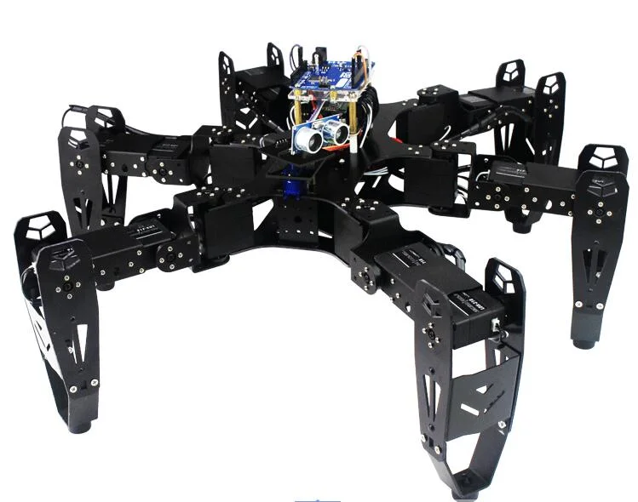
Q: Have you played with a robot before?
Q. How does your robot look like?
Q. Can you draw a picture of the robot that you know?
Q. Look at what we have here? Do you consider this spider as a robot?
Q. In what way is this spider also a robot?

Slide 4
Robot with and without intelligence?
What can a robot do so that it can be considered an intelligent robot?
Look at the spider robot, is it an intelligent robot?
What makes you consider it intelligent? What tasks does it perform that makes you consider it intelligent? List these tasks.

Slide 5
The Spider Robot
It can see, listen to command, answer questions, perform actions as requested, and what else?
Do you think it can solve problem?
What kind of problems do you think it can solve?

Slide 6
Artificial intelligence
Given your expectation of what a robot can do, try to define artificial intelligence.
The goal of AI is to make a machine perform tasks that otherwise require human intelligence to perform.
Some examples of such tasks.
Learning.
Seeing.
Listening and understanding speech.
Differentiate between voice.
Natural language understanding.

Slide 7
Machine learning and Degree of intelligence
Robot with limited intelligence
Need to follow specific instructions.
: Follows explicit instructions and predefined algorithms to perform tasks. It processes data based on fixed rules set by programmers.
Robot with more intelligence
: Uses algorithms that allow it to learn from data and improve over time. AI systems can adapt their behavior based on experience, making them more flexible.

Slide 8
Can you tell if a robot is as intelligent as human?
How can you find out?
What if a robot is as intelligent as human, how would you use it?

Slide 9
Examples of CV
Use the shopping shelf

Slide 10
Examples of speech
Use the spider

Slide 11
Example of NLP
Use the spider

Slide 12
Example of machine learning
Use the fish?

